Slide 1
EE 2361: Introduction to Microcontrollers
Peng Li
lipeng@umn.edu
07/24/2015

Slide 2
Topics
SPI Examples
FIFO Buffer
PIC24 Oscillator Configuration

Slide 3
Example 2 – 74HC595
Describe how to use two 74HC595 to drive up to eight common-cathode seven-segment displays.

Slide 4
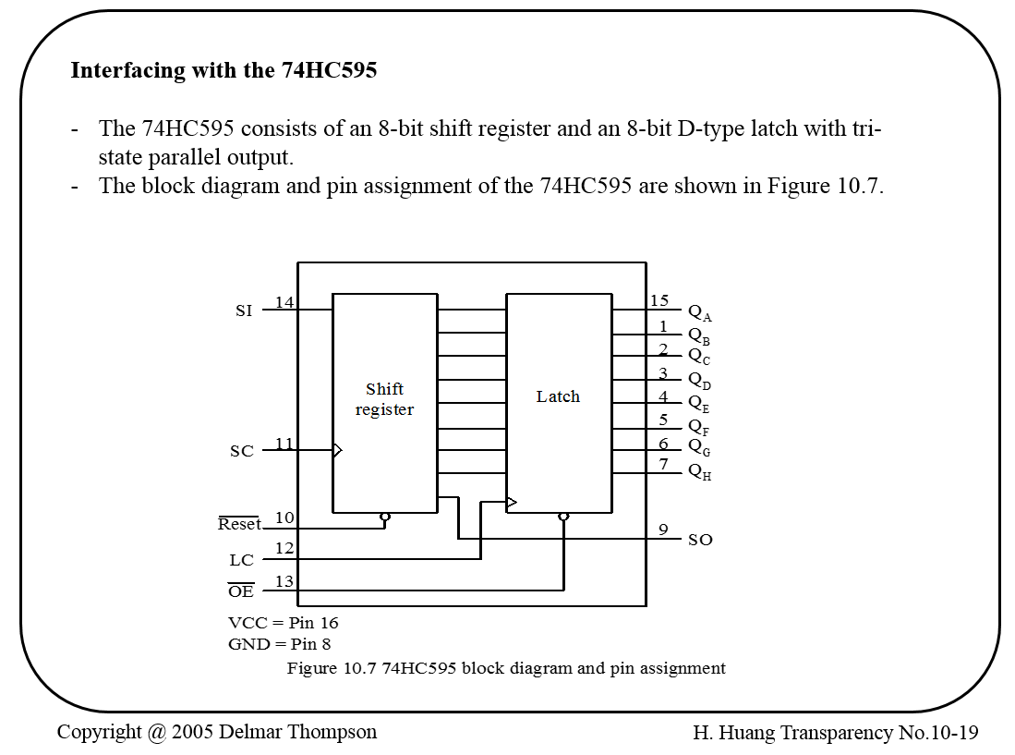
Example 2 – 74HC595

Slide 5
Example 2 – 74HC595
Operations of the 74HC595
The SI and SO pins are the serial input and serial output, respectively.
The data is shifted in on the rising edge of the SC signal.
The value of the shift register will be loaded into the output latch on the rising edge of the LC signal.
The 74HC595 can be used to add parallel output ports to the PIC24.

Slide 6
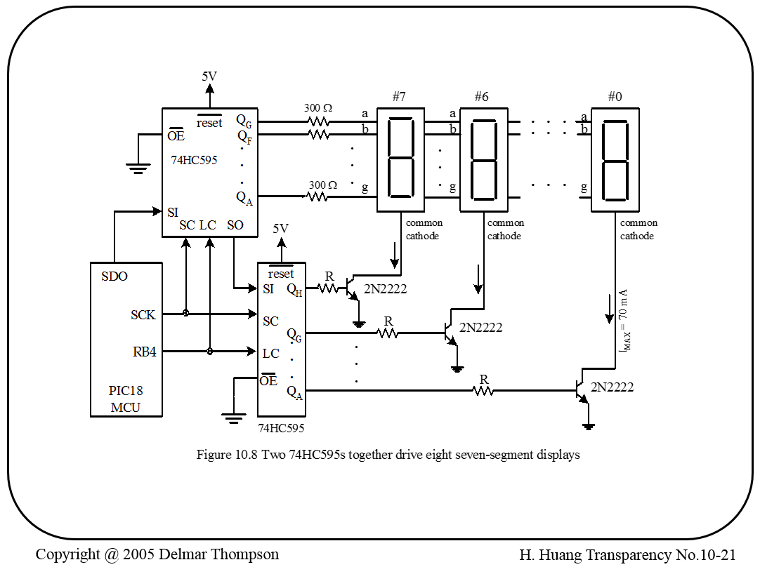
Example 2 – 74HC595
PIC24 MCU

Slide 7
Example 2 – 74HC595
We will need to develop two tables to control the segment patterns and display select signal.
Using time-multiplexing technique to enable each display every 1ms.
We will send a 16-bit word using the SPI. The most significant byte is for display selection, the least significant byte is for segment patterns.
Enable the latch after the data have been transferred to the shift register. (Question: how to implement this in your code?)

Slide 8
Page 11 of PIC24-SPI datasheet.

Slide 9
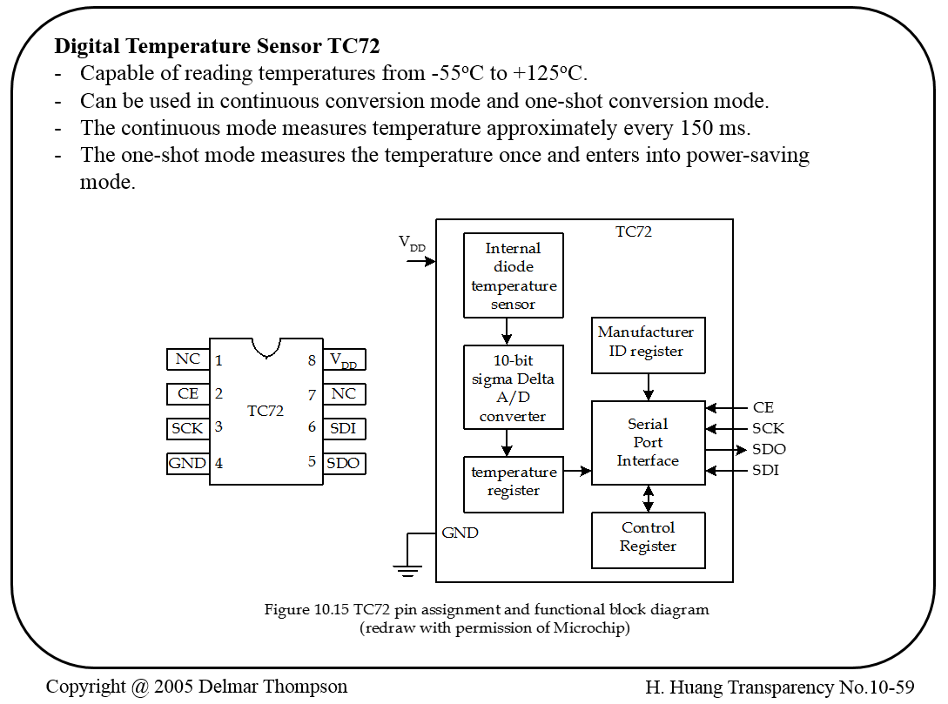
Example 3 – Digital Temperature Sensor TC72

Slide 10
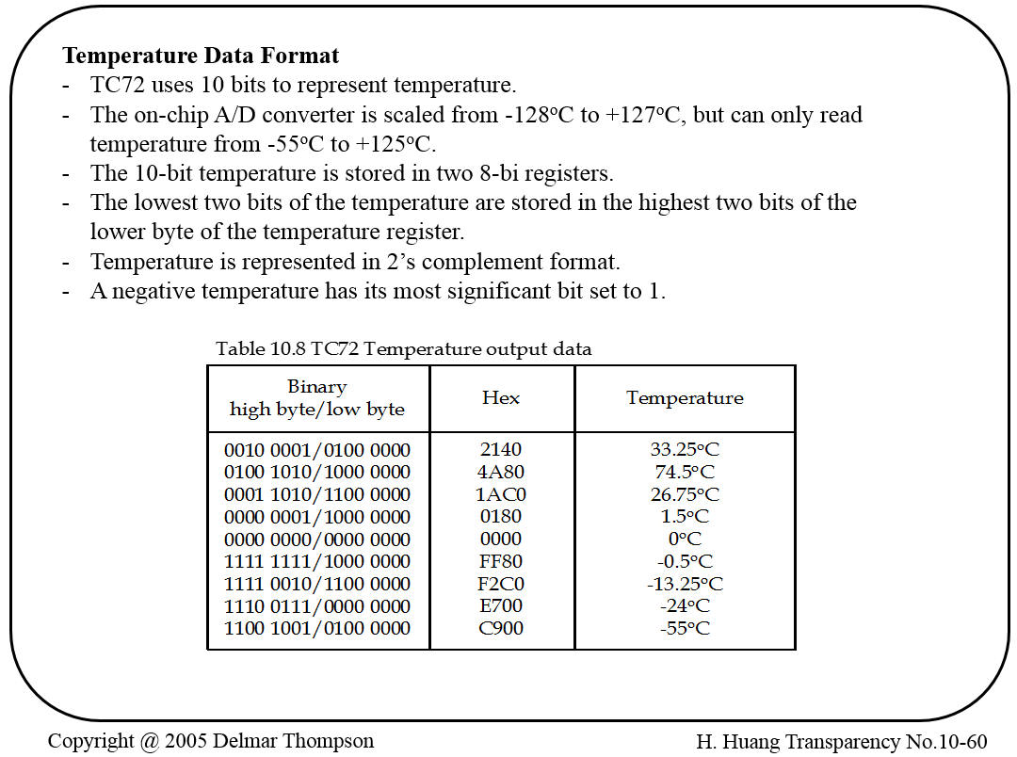
Example 3 – Digital Temperature Sensor TC72

Slide 11
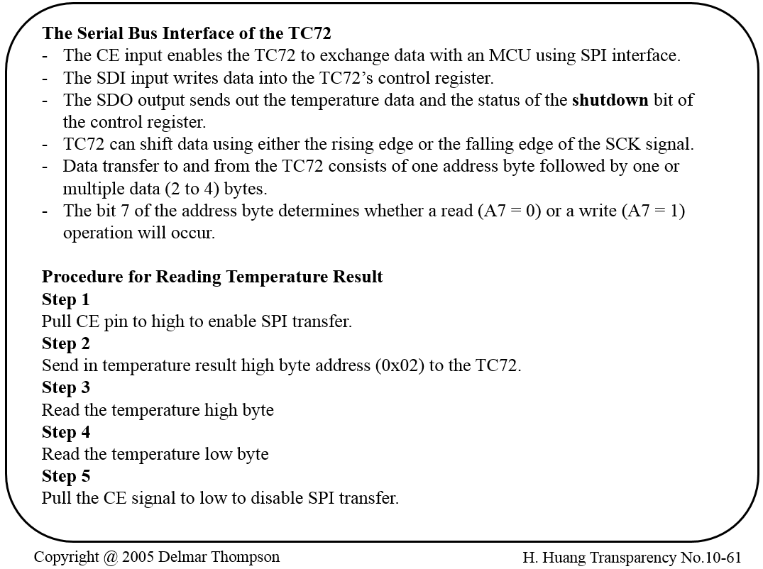
Example 3 – Digital Temperature Sensor TC72

Slide 12
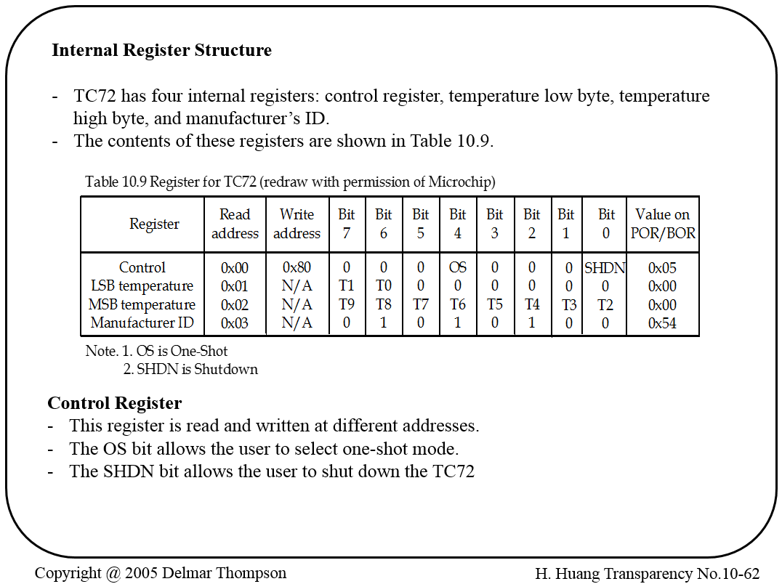
Example 3 – Digital Temperature Sensor TC72

Slide 13
TC72 Multiple Byte Transfer
Page 11 of TC72 Datasheet
TC72_CE = 1; // Enable TC72 data transfer. SPI1BUF = 0x02; // Send the MSB address
while (!SPI1STATbits.SPIRBF); // wait for transfer completion
Temp = SPI1BUF; // clear SPIRBF flag
SPI1BUF = 0x00; // read the temperature MSB data
while (!SPI1STATbits.SPIRBF); // wait for transfer completion
MSB_Temperature = SPI1BUF; // store the temperature MSB data
SPI1BUF = 0x00; // read the temperature LSB data
while (!SPI1STATbits.SPIRBF); // wait for transfer completion
LSB_Temperature = SPI1BUF; // store the temperature LSB data
TC72_CE = 0; // Disable TC72 data transfer.

Slide 14
Example 3 – Digital Temperature Sensor TC72
Exercise: describe the circuit connection between the PIC24 MCU and TC72 for digital temperature reading and write a C program to read the temperature every 200 ms.

Slide 15
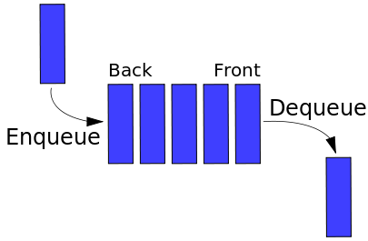
FIFO (First In, First Out)
A method for organizing and manipulating a data buffer, where the first entry is processed first.
Used in storage device command scheduling, computer communication and networking.
Device A
Device B
Other Logic
https://en.wikipedia.org/wiki/FIFO_(computing_and_electronics)

Slide 16
FIFO Implementation
For PIC24 microcontroller, it makes more send to use the UART module to show how the FIFO buffer works, but I will use the INT0 and PORTB to show how it works for simplicity.
Coding Example: buffer1.c & buffer2_circular
Question: what’s the difference between the two codes?

